Slide 1
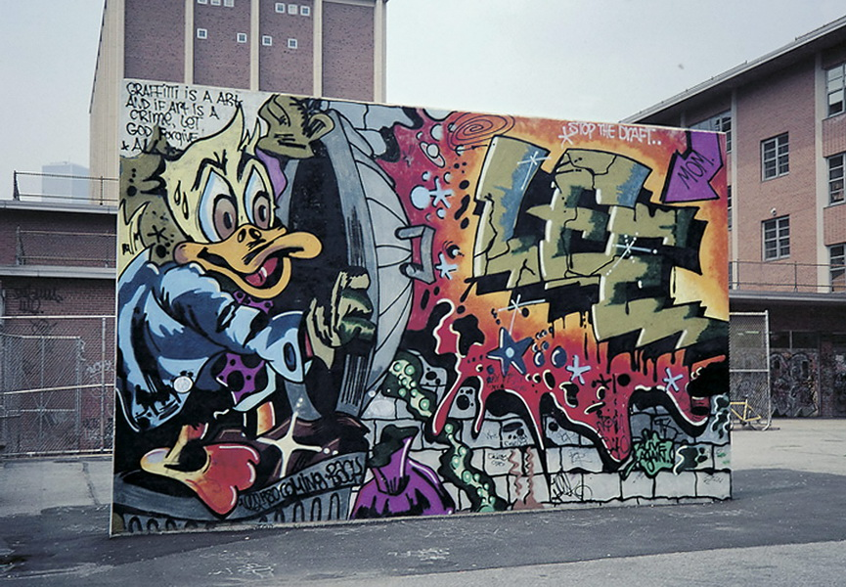
W200 Project 2 Graffiti Analysis in Saint Paul, Minnesota
Spring 2021 Section 5
Mia Yin
Jude Wentian Zhu

Slide 2
Overview
Graffiti in St. Paul, MN
▪Location ▪ Graffiti Surface ▪ Time Series ▪ Cleanup Cost Analysis
Question:
How is graffiti distributed across St. Paul?
Is graffiti clustering associated with crime rate in St. Paul as suggested in many research articles?
How likely does graffiti tend to recur at the same location?
Is there any visible trend of what surface do the vandals prefer?
What are the general trends of graffiti cases from 2013 to 2015, any seasonality?
What insight can we draw from the cost analysis for graffiti cleanup work?
Dataset: Graffiti related issues responded to by the Parks and Recreation Department from 2013 to 2015.

Slide 3
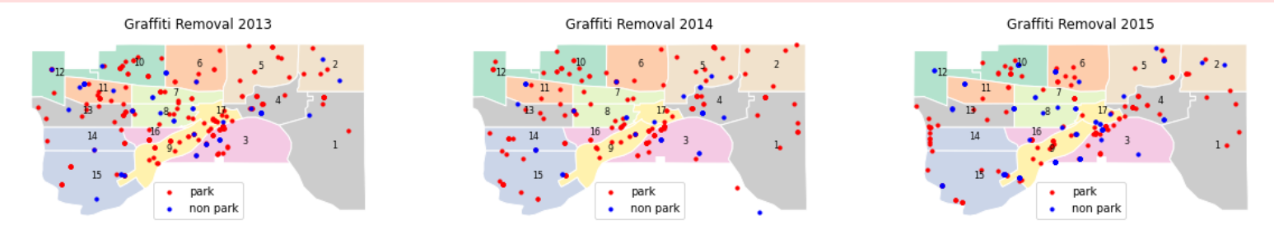
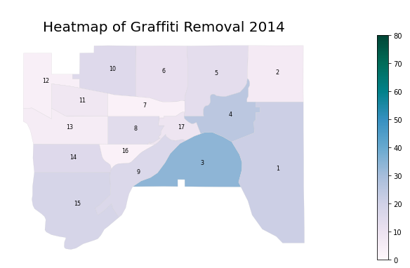
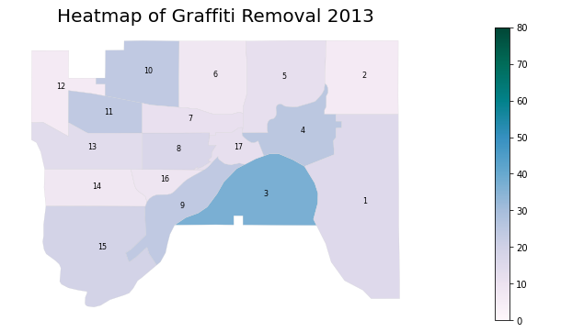
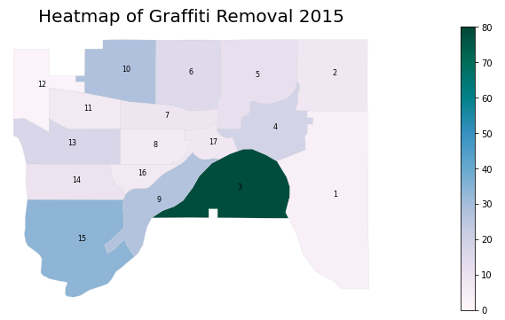
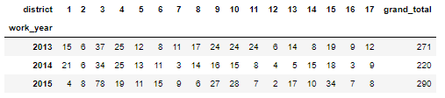
Q1
How is graffiti distributed across St. Paul?
Supplemental dataset: St.Paul district map shapefile
Park more popular than non park
Graffiti scatters across the city, with no oblivious signs of migration
District 3 has a surge of cases in 2015

Slide 4
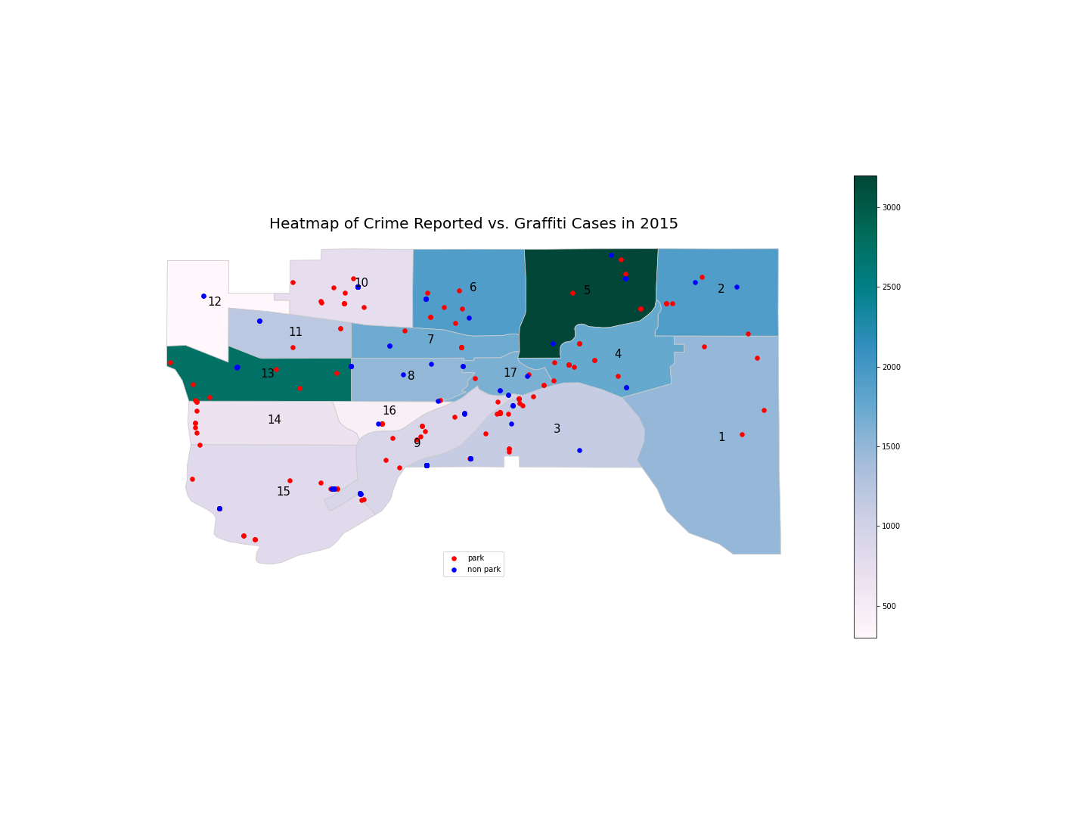
Q2
Is graffiti clustering associated with crime rate in St. Paul?
Supplemental dataset: St. Paul crime report 2015 data
Assumption: higher graffiti density leads to increased crime rates
The heatmap represents the density of crime reports (number of crimes reported in the district).
Unfortunately, the comparison does not support my assumption.

Slide 5
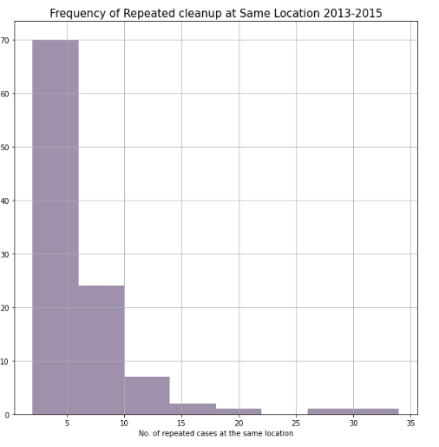
Q3
How likely do graffiti tend to recur at the same location?
Many locations incur repeated graffiti cleanups.
Most locations has around 5 repeated graffiti cleanups, some locations undergo 30+ cleanups but such case is rare.

Slide 6
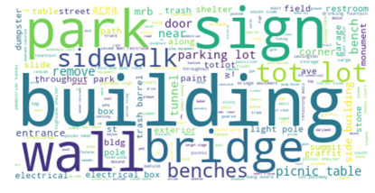
Q4
Is there any visible trend of what surface do the vandals prefer?
Size of the word represents the frequency.
It is interesting to notice that building, wall, bridge, park, sidewalk, tot lot, parking lot are among the most frequent graffities surface.
Among these, building appears to be vandals’ favorite spots.

Slide 7
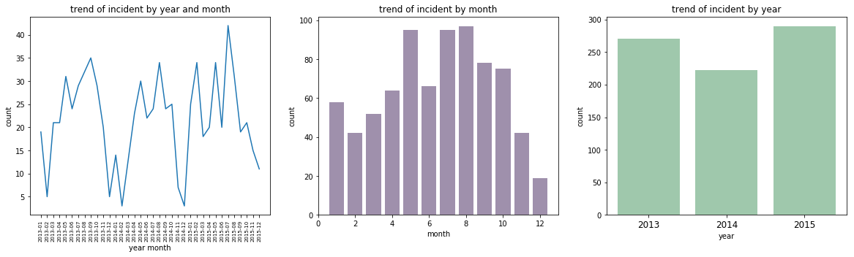
Q5
What are the general trends of graffiti cases from 2013 to 2015, any seasonality?
May, July, August are the months when graffities counts are the highest.
December always has the lowest graffiti counts which seems reasonable, because December is a holiday season.

Slide 8
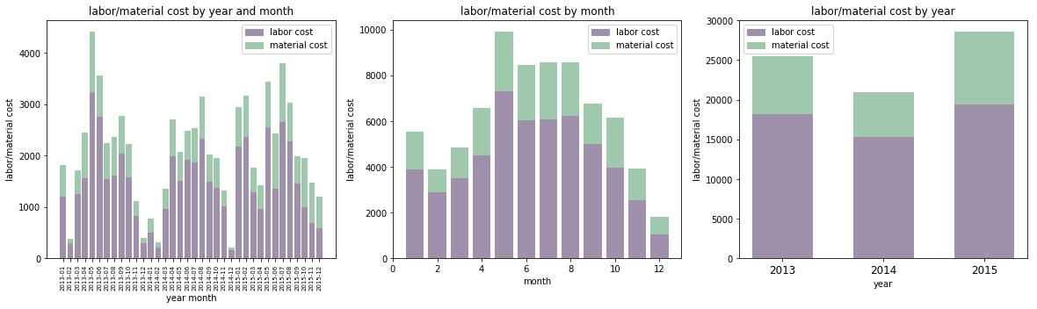
Q6
What insights can we draw from the cost analysis for graffiti cleanup work?
Total cost trend is consistent with the total graffiti case trend, indicating a consistent unit cost for graffiti cleanup.
Labor cost is consistently higher than material cost. Graffiti removal is indeed heavy labor work!

Slide 9
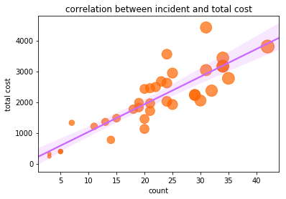
Q7
Is there any correlation between incident and total cost?
Larger bubbles correspond to higher total cost
Bubble size grows in proportion with total graffiti cases, which further validates the close association between case count and total cost.

Slide 10

Conclusion
1. Graffiti occurs more frequently in parks than non-parks
2. Graffiti clustering does seem to be present in some districts.
3. The association between graffiti and crime rate in St. Paul is weak.
4. Repeated cleanups.
5. Building, wall, bridge, park, sidewalk, tot lot, parking lot are the favorite graffiti places for vandals.
6. Graffiti cleanup does display time trend and seasonality – peak in summer and trough in winter.
7. Graffiti cleanup is labor intensive work, as demonstrated by high labor cost as proportion of the total.
8. Linear relationship between cleanup cases and total costs - stable unit cleanup price.

Slide 11


